Slide 1

IoT Intrusion Detection
By: Braydon Reid

Slide 2
Agenda
Data Loading & Cleaning
Feature & Target Definition
Encoding & Label Handling
Train/Test Split & Scaling
Model Evaluation Function
Baseline Models
Hyperparameter Tuning
Results Saving
Why No LSTM?
Results
Conclusions

Slide 3

Data Loading & Cleaning

Slide 4
Feature & Target Definition

Slide 5
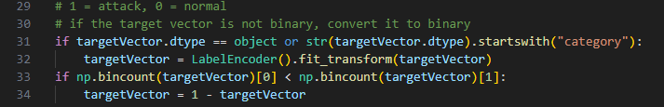
Encoding & Label Handling

Slide 6
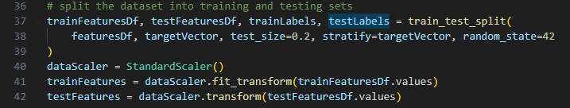
Train/Test Split & Scaling

Slide 7
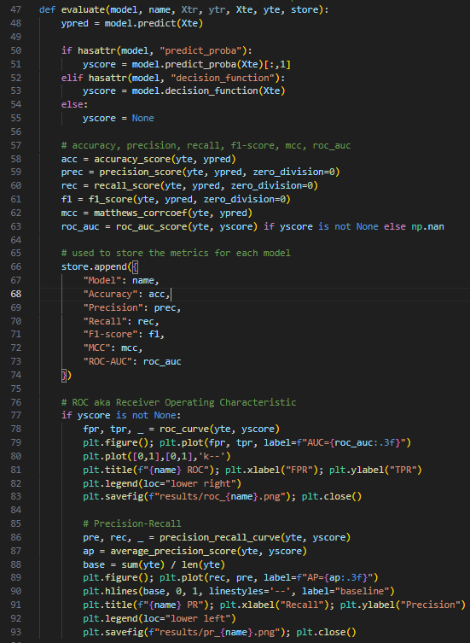
Model Evaluation Function

Slide 8
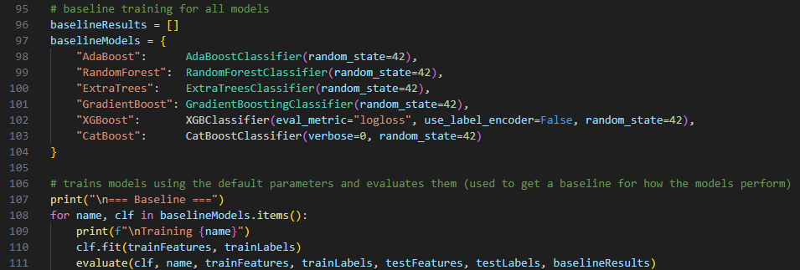
Baseline Models

Slide 9
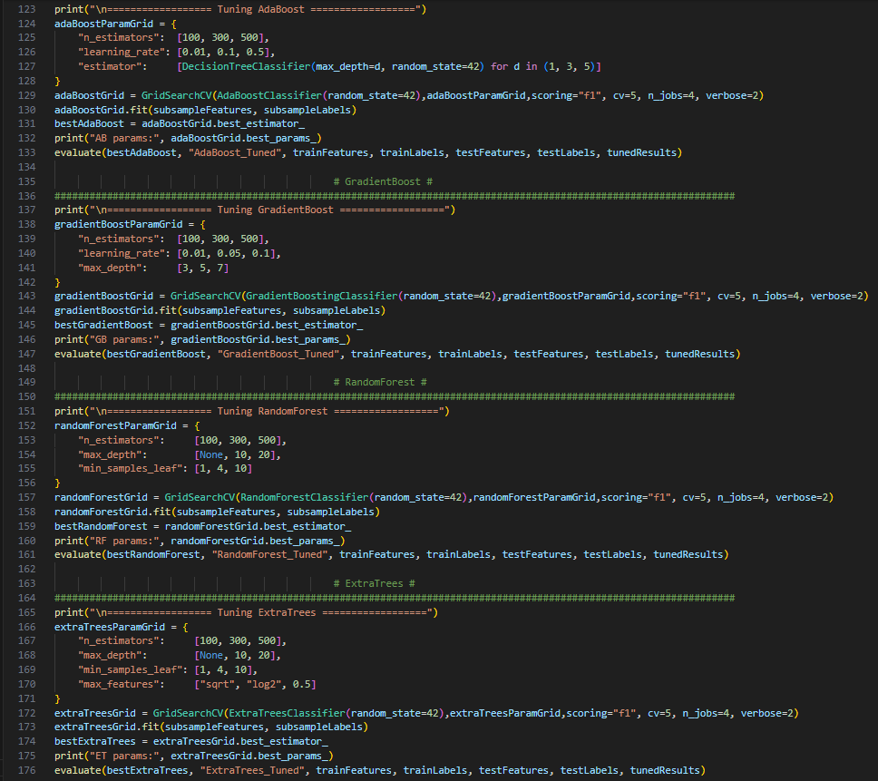

Slide 10
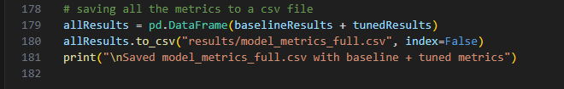
Saving Results

Slide 11

Why No LSTM?
Data was already put into summarized data:
Means
Counts
min/max
This made LSTM not necessary

Slide 12

Metrics Used
Accuracy
Precision
Recall
F1-Score
MCC (Matthews Correlation Coefficient)
ROC/AUC (Receiver Operating Characteristic/Area Under the Curve)

Slide 13
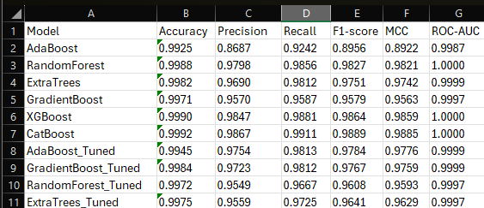
Results

Slide 14
Result Concerns
Possible Overfitting
Premade dataset
Pre-Cleaned
Less Noise

